Slide 1



Marketing and Retail Analytics – Coffee Café
Mini Project – Coffee Café Restaurant
Name: Numer P
Batch: PGP-BABI Nov’ 2019
Marketing and Retail Analytics – Coffee Café

Slide 2
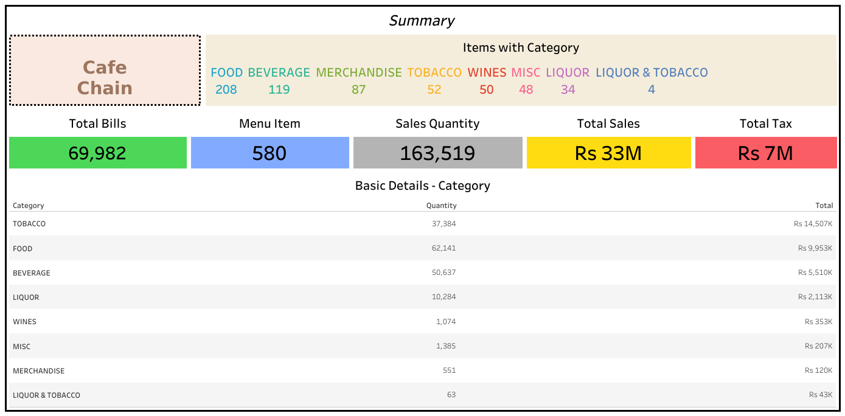
Marketing and Retail Analytics – Coffee Café
Cup 1
The restaurant have maximum turnover of ₹ 33 Million over 69,982 bills generated.
Menu shows that customer may avail the items over unique 580 tasty snacks and foods at their mean time.
The particular branch is making higher sales in Tobacco Items with turnover of ₹ 14,507K.
The least products preferred by the customers is for Liquor and Tobacco with sales of ₹ 43K.
Restaurant offering various items in all categories which is special in Food Items with 208 items and Beverage with 119 Items.
Customers are preferring buying food items than other items in the restaurants.
Marketing and Retail Analytics – Coffee Café

Slide 3
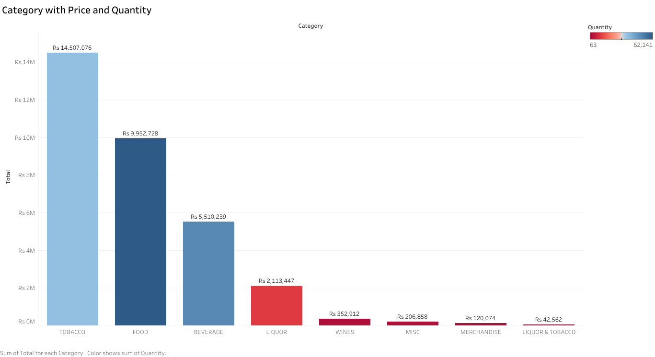
Marketing and Retail Analytics – Coffee Café
The chart shows the Item category with Sales and Quantity
Higher Sales – Tobacco | High Quantity – Food | Less Sales and Quantity – Liquor & Tobacco
Cup 2
Tobacco have higher sales with ₹14,507,076 in the overall food category and with second in quantity of 37,384
The red bar shows that item category are measured with below median Quantity and contribute less in sales.
Liquor, Wines, Merchandise Items and Liquor & Tobacco Items are contributes the lesser sales and customers are preferring this items in seasonal changes.
The Item Categories are classified by the menu items and customer prefers more in foods items than higher sales contributor Tobacco.
Marketing and Retail Analytics – Coffee Café

Slide 4
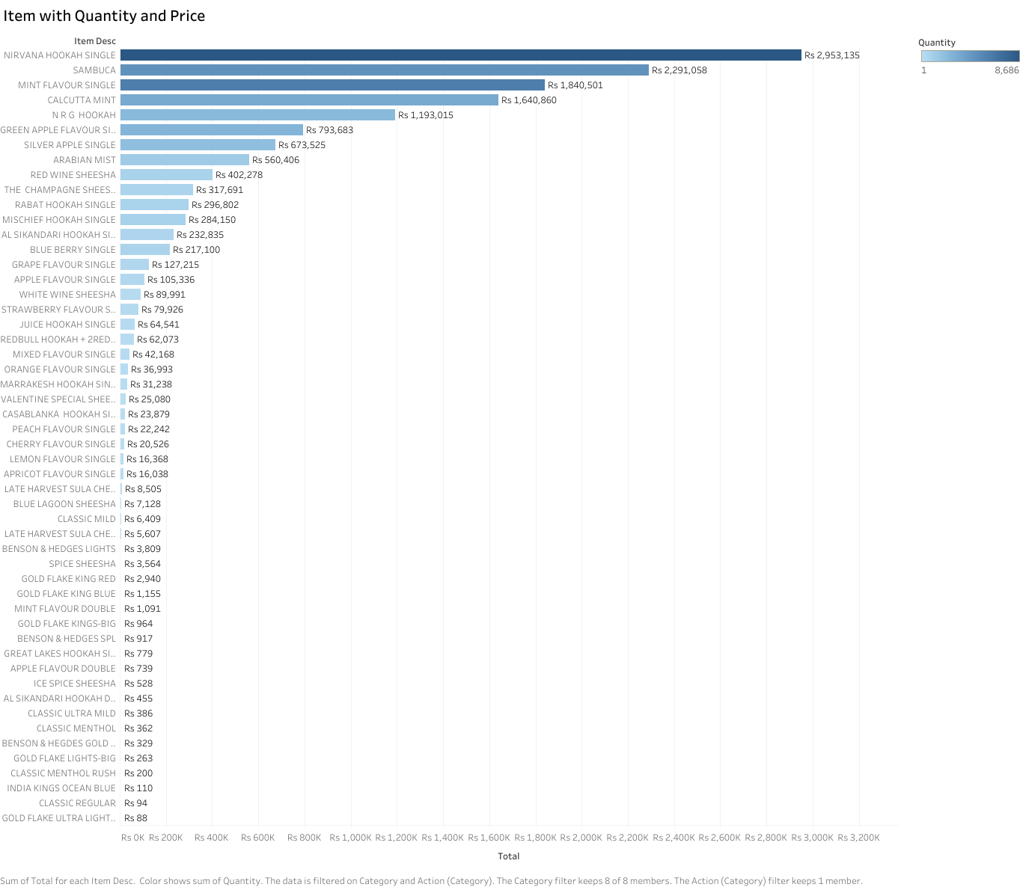
Marketing and Retail Analytics – Coffee Café
Chart shows Item with Price
Higher Sales – Nirvana Hookah Single | Lower Sales – Gold Flake Ultra Lights
Nirvana Hookah Single is the most selling item in the restaurant which offer maximum sales with ₹ 2,953K
Next to Nirvana Hookah Single customers are preferred to buy Sambuca with higher sales of ₹ 2,291K
Gold Flake Ultra Lights is contributing less in sales and the customers are buying with less quantity which sales around ₹ 88.
As Food Items contribute more in quantity of sales and Great Lakes Milkshake provides the higher sales with ₹843K and quantity with 5,914.
In Food Items, Mothers Day Special Item have contributes sales with 5 quantity and ₹ 0 which is intend to free item.
Carlsberg is preferred by most of customer with 3380 Units sold and generate ₹ 539 K
Cup 3
Marketing and Retail Analytics – Coffee Café

Slide 5
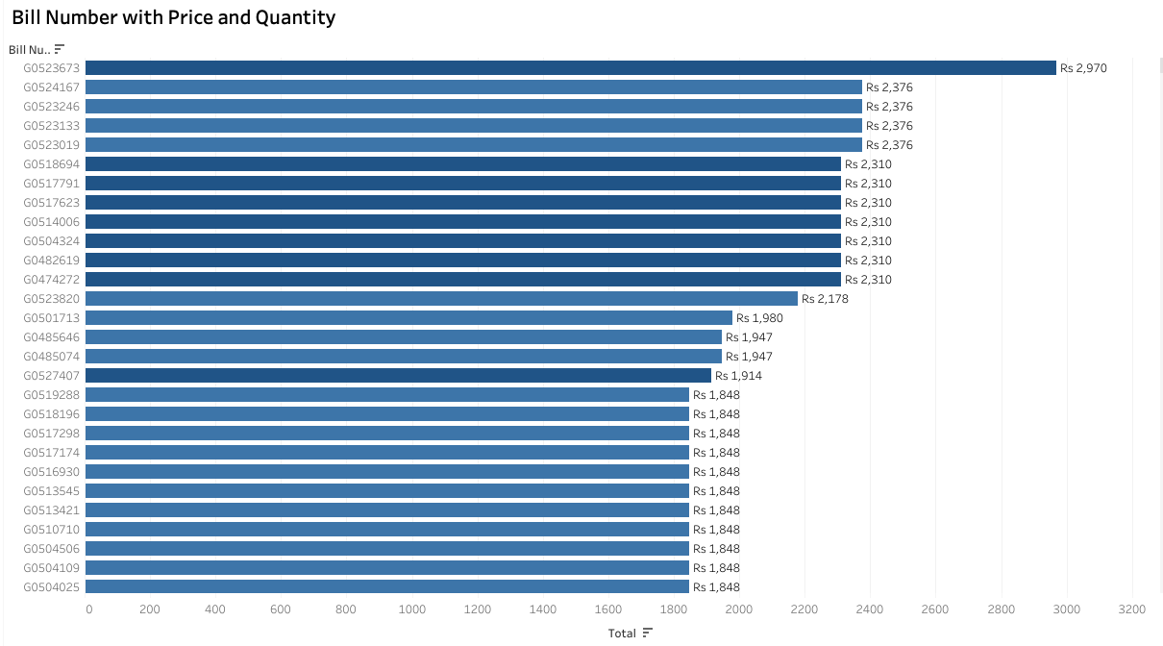
Marketing and Retail Analytics – Coffee Café
The chart shows the Bill Number with Sales
Higher Sales – G0523673 | Quantity – Min. 1 Max. 5 | Less Sales – G0470683
Cup 4
Customer Bills are analyzed with higher sales of ₹2,970 for the Bill number G0523673 and lowest sales of ₹88 for the bill G0470683
The quantity purchased by each bill is maximum 5 quantity and minimum of 1 quantity in which the bill may consists of combos and free items is counted.
The maximum bills counted for the period of April, 2010 to March, 2011 with 69,982 bills.
The bills tagged with sales amount of ₹ 2,970 ₹2,376 ₹2,310 have purchased with 5 quantity, bills with ₹1000 ranges are purchased with 4 and 3 quantity. The bills tagged with sales amount in hundred ranges are purchased with 1 and 2 quantity of items.
Marketing and Retail Analytics – Coffee Café

Slide 6
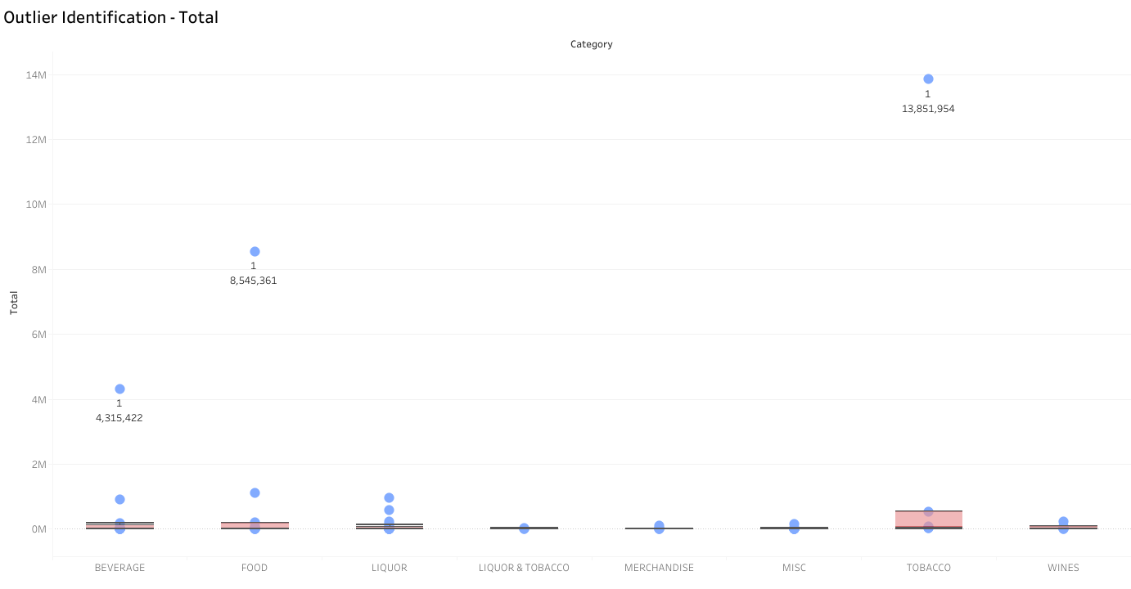
Marketing and Retail Analytics – Coffee Café
Box Plot shows the Outlier Identification of Item Category
Cup 5
Beverage category shows the quantity of 1 with price of 4,315,422
Food items with 1 quantity have made sales of 8,545,361
Liquor items with 1 quantity have made sales of 943,585
Liquor and Tobacco items made higher sales of 31,342 as well as lowest sales of 1,980 with 1 quantity.
Merchandise is purchased with 1 quantity of 99,774.
Miscellaneous items have been purchased with 1 quantity of 155,144.
Wines with 1 quantity of 232,987.
Tobacco have made sales of 13,851,954 of 1 quantity which is higher in the restaurant.
Marketing and Retail Analytics – Coffee Café

Slide 7
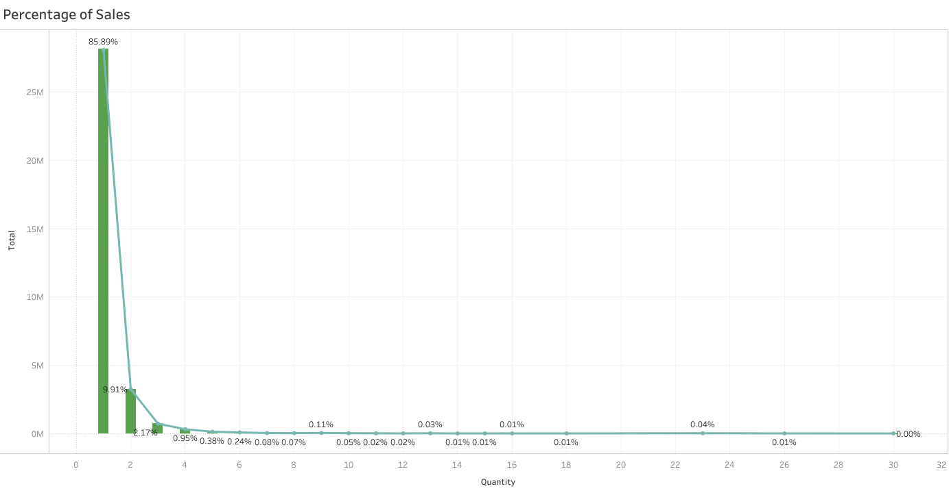
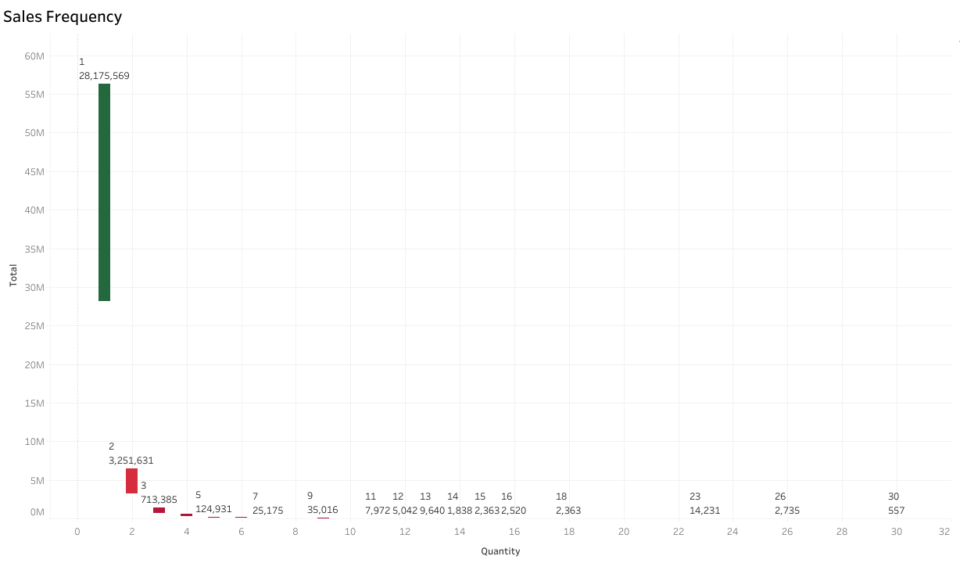
Marketing and Retail Analytics – Coffee Café
Percentage and Frequency of Sales with Quantity
The Frequency chart shows the distinguishing of the less quantity is contributing higher sales and same as percentage of sales in the Restaurant
Cup 6
Percentage of sales shows that 1 quantity purchaser are higher in the restaurant sales and contributes of 85.99% of total sales of ₹28 Million in total sales.
The 2 units of quantity have contributed for the 9.91% of total sales of ₹3 Million and 3 units of quantity have contributed 2.17% of ₹713 K and 4 units of quantity have contributed 0.95% of total sales with ₹310 K.
Percentage is decreasing constantly with quantity increasing in units. 30 units of quantity shows 0% contribution in sales.
Marketing and Retail Analytics – Coffee Café

Slide 8
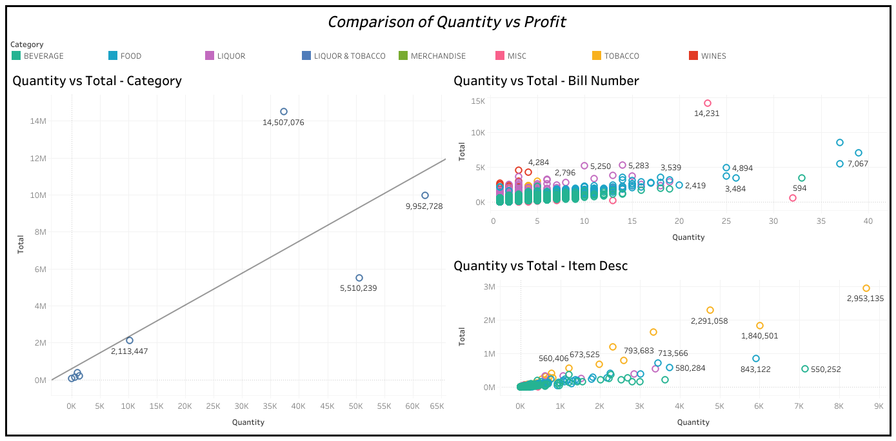
Marketing and Retail Analytics – Coffee Café
Comparison of Quantity vs Profit
Cup 7
Item Category shows that increased quantity with increased sales for Food Items and decreased quantity with decreased Sales for Liquor, Wines, Liquor and Tobacco.
Bill Number shows the comparison with Item Category explains that beverage items are maintain its quantity and price are constantly in values and Food category is scattered across plots which shows variations.
Item Description shows the quantity and price is following pattern which shows increased in item quantity increases in Price too and the maximum is targeted by Tobacco items.
Marketing and Retail Analytics – Coffee Café

Slide 9
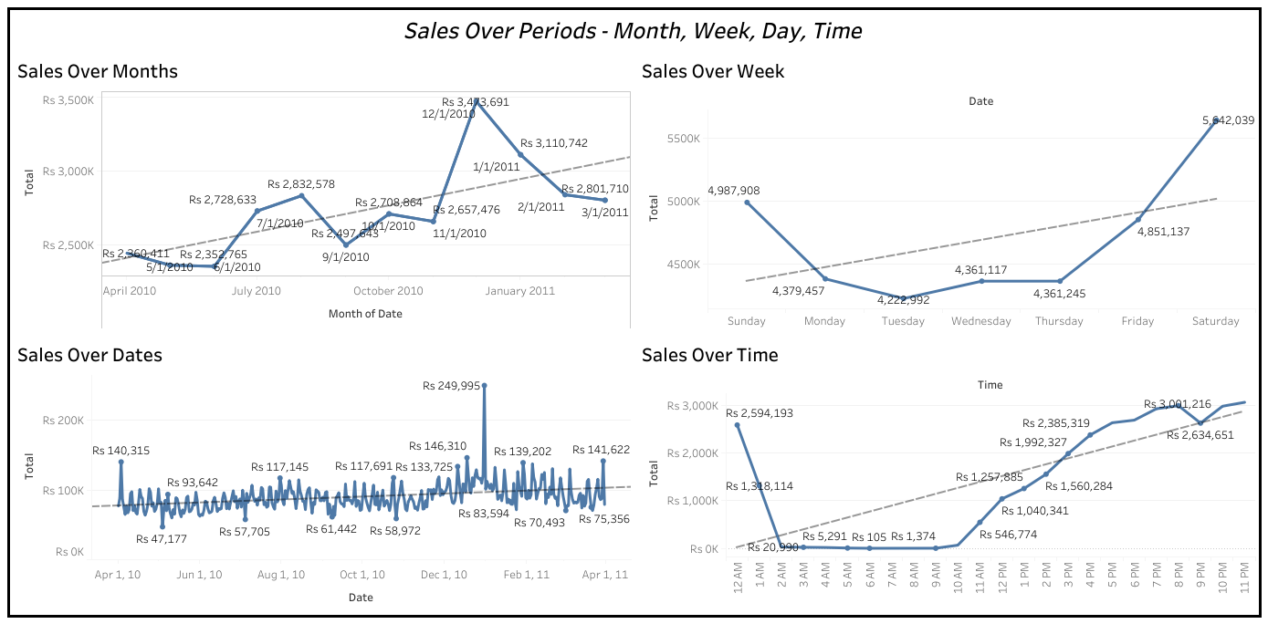
Marketing and Retail Analytics – Coffee Café
The Line Charts explains the Sales over Months, Week, Days and Time
Line chart explained with increasing trend over the period of the overall Time
Cup 8
Sales over Months shows that highest peak in December and lowest sales in May and June. The highest sales recorded in December is ₹3,474K
The sales over week is showing the Increase - Decrease - Increase pattern which is fluctuated and shows highest sales in Saturdays with ₹5 Million
Days are showing the normal seasonality found in the trend which is constant and showing highest sales on December 31st of ₹250K which is not measured in 365 days.
Peak hours of the café restaurant is measured from 3 PM to 12 AM and sudden decrease from 1 AM which shows seasonal changes in the sales. The highest peak time measured as 8 PM with sales of ₹ 3,001 K
The increasing trend shows the P value < 0.5 which is significant in all variable periods and can be impute in increased sales for the next set of months, weeks, days and time.
Marketing and Retail Analytics – Coffee Café

Slide 10
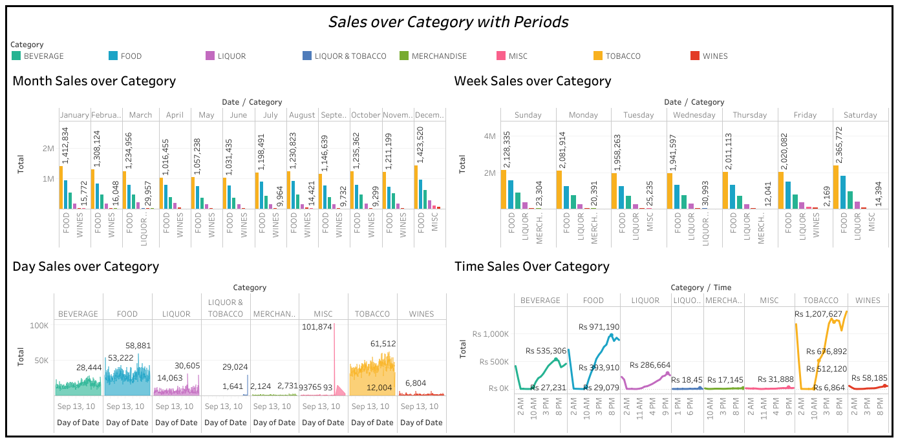
Marketing and Retail Analytics – Coffee Café
Category wise study over Periods
Cup 9
Overall Period of Time, Tobacco has achieved the highest sales record and have contributed more to the restaurant.
The Tobacco Item sales is peak in overall time period and followed by Food has majority of contributor.
The Miscellaneous category shows that December 12, 2010 have noticed the sales with ₹101,874 Million. But the overall contribution shows Tobacco and Food are majority in sales increase and this impact shows that December 31st is with special item (billed as Miscellaneous) that increased the sales.
Saturday is placing the higher sales and higher quantity of units sold then compared to Sunday and makes the same pattern of purchase behavior through out the week.
Item Category – Liquor and Tobacco, Merchandise, Miscellaneous, Wines are showing the constant through out the day.
Liquor sales shows peak around 6 PM to 12 PM and shows that drinkers availability in that particular time along with Tobacco sales increased values.
Marketing and Retail Analytics – Coffee Café

Slide 11
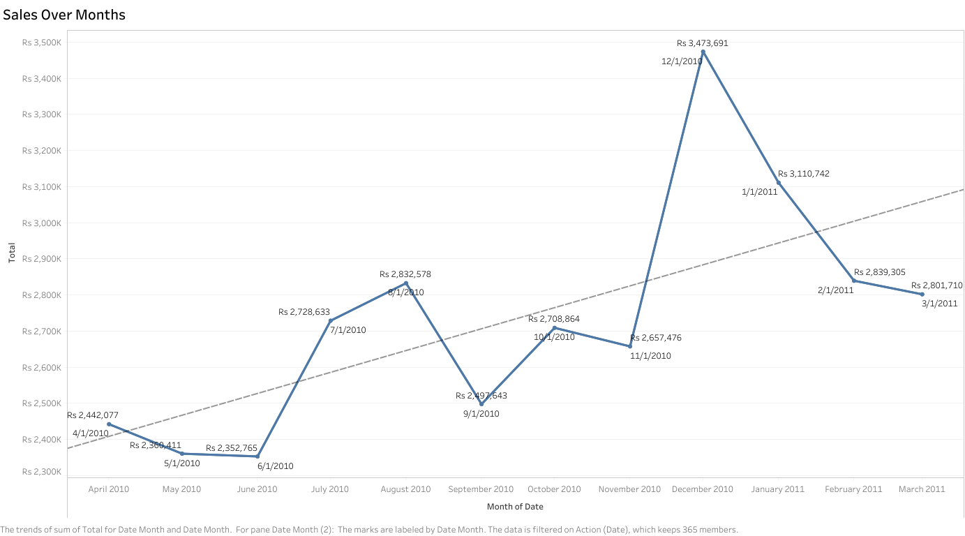
Marketing and Retail Analytics – Coffee Café
Sales Trend Over Months – Increasing Trend is observed in the period from April, 2010 to March, 2011
Cup 10
The trends are observed with increasing price over the period of December month and the acquired the maximum profit of the time period ₹3,474K.
The increasing trend shows that the seasonality is observed with the trends increasing from November to December and again dropping down in January to February and complete low in March. As the data implies and the increasing trend observed in July and August with the P Value < 0.05 is significant with maximum profit to the restaurant.
The sales values is decreased in May, June, September as it indicates the Quarterly price is observed as low sales and have to improvise the Quarter Report of sales.
Marketing and Retail Analytics – Coffee Café

Slide 12
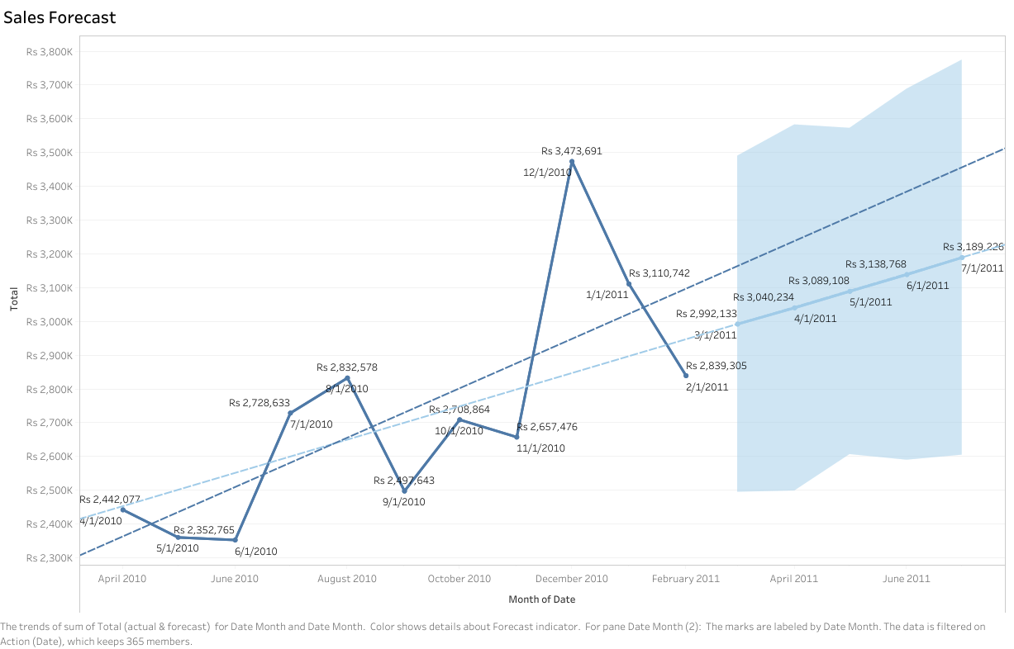
Marketing and Retail Analytics – Coffee Café
Increasing Trend is observed and the forecasted sales of the Restaurant is Predicted
Cup 11
The forecasted trend shows the increased sales from May month and observed for next three months and the sales observed in Forecasted July 2011 Month is ₹3,189K which shows the increased sales from July 2010 with ₹2,729K.
Marketing and Retail Analytics – Coffee Café

Slide 13
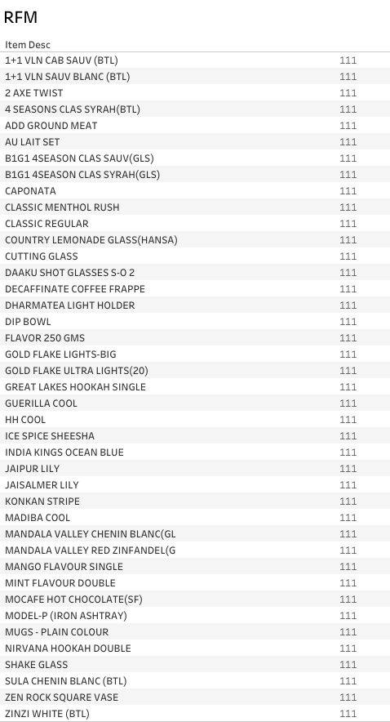
Marketing and Retail Analytics – Coffee Café
Menu Items are classified with Marketing Methodology
RFM – Recency, Frequency and Monetary
Cup 12
RFM values with Highest Score is 555 RFM values with Lowest Score is 111
Since many item is measured with lower quantity in sales and customer interest towards the product is low, RFM scores is computed for the best analysis.
The lowest score are measured as 111 and the items are labelled in the table. The Menu may exclude the items as the it measures that very less recency in customer preferring the products, frequency of buying the products by the customer is very low and the Monetary of the product is very less. Hence, this item is excluded from the menu items and may provide this item to increase the sales further.
The labelled items may be in decreased value of not having popular taste among the customers, may be avail only during the festive or seasonal time. Hence, the items can be increased in customers sales by advertising frequently and giving promo codes to the products or as a combo in meals will help the products existing in the menu list.
Marketing and Retail Analytics – Coffee Café

Slide 14
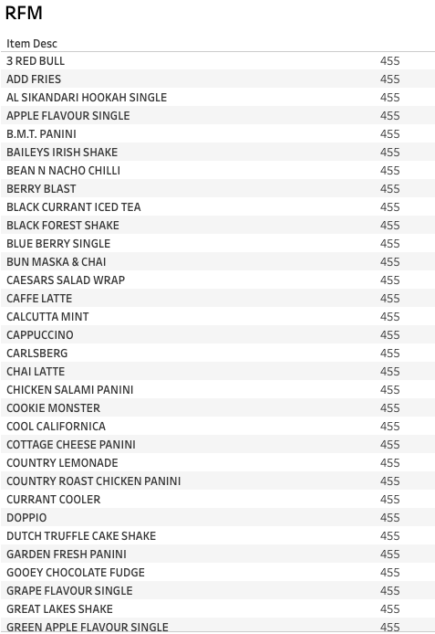
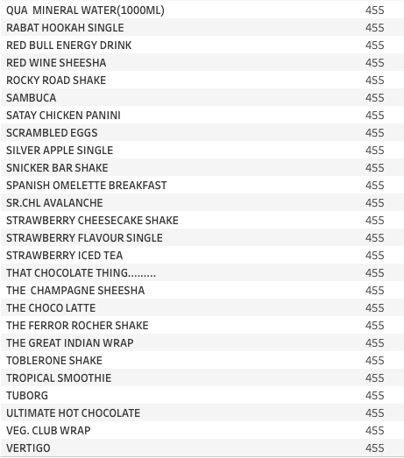
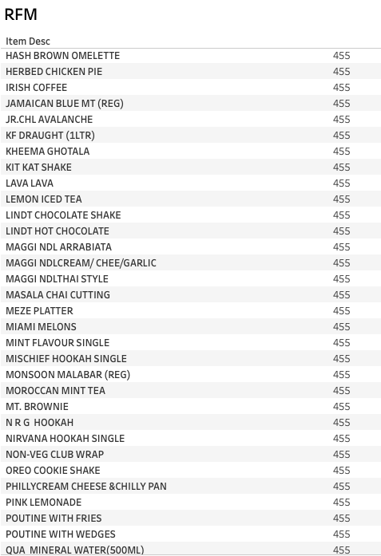
Marketing and Retail Analytics – Coffee Café
Cup 13
The RFM values with higher values for the coffee restaurant items is measured with 455 as labelled with higher recent in purchase of items, higher in frequency of the customers buying the items and increased monetary values for the labelled items in the table.
This items are marked for the higher contribution in the sales of the restaurant. Hence the items are valued for the items and increased in the menu items. The menu items are increased with the labels and the least RFM values are with lesser items.
Marketing and Retail Analytics – Coffee Café

Slide 15
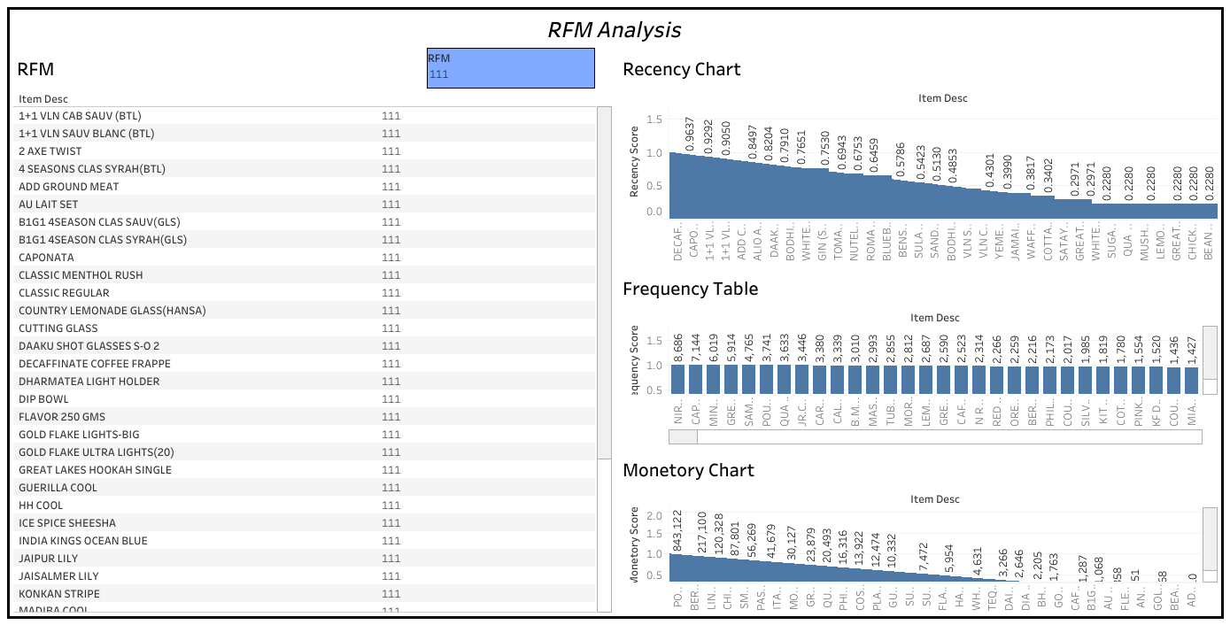
Marketing and Retail Analytics – Coffee Café
Cup 14
The Dashboard explains the RFM analysis with the pattern in observing the chart values and explained with the least RFM values and the higher frequency of the ₹8,686 of the highest item and the monetary chart with increased value of 843.32 in the least RFM.
Marketing and Retail Analytics – Coffee Café

Slide 16
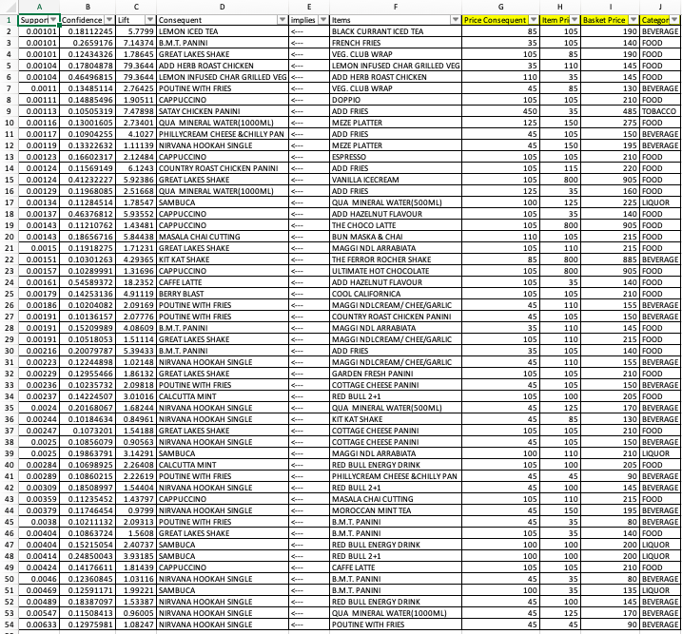
Marketing and Retail Analytics – Coffee Café
Market Basket Analysis
Cup 15
The Probability of the customers buying items is identified with the items and the related items bought with the customer preference.
The Market Basket Analysis is measured with the values and prices are matched with the actual prices in the original datasets and the category is selected for the variables in the datasets.
The item are measured with the Association Rule Learner in KNIME (Total Rules: 52) for the best understanding of customer behavior in the buying the items from various categories and VLOOKUP for Prices in excel.
The menu items are measured with the Support, Lift and Confidence in the analyzed data of the measured values.
The Basket Price is associated for the consequent values in the Market.
Marketing and Retail Analytics – Coffee Café

Slide 17
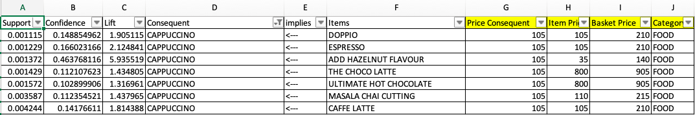
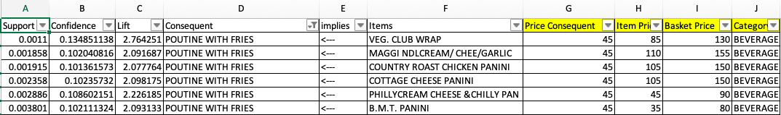
Marketing and Retail Analytics – Coffee Café
Basket 1
Cup 16
The Basket 1 is filtered with the consequent items where the items selected as Doppio, Espresso, Add Hazelnut Flavor, The Choco Late, Ultimate Hot Chocolate, Masala Chai Cutting and Café Latte can be selected along with Cappuccino as Basket Price.
The Basket Price of the 1st Basket is ranges between ₹140 to ₹905 of the basket items. In which the Basket 1 is offered and recommended Basket is Cappuccino and Add Hazelnut Flavour for the customer.
Basket 2
The Basket 2 is measured for the combo of Poutine with Fries and B.M.T Panini as the highest offering to customers with price of ₹80
Marketing and Retail Analytics – Coffee Café

Slide 18
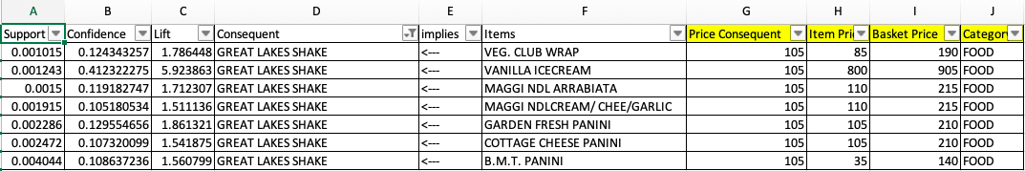
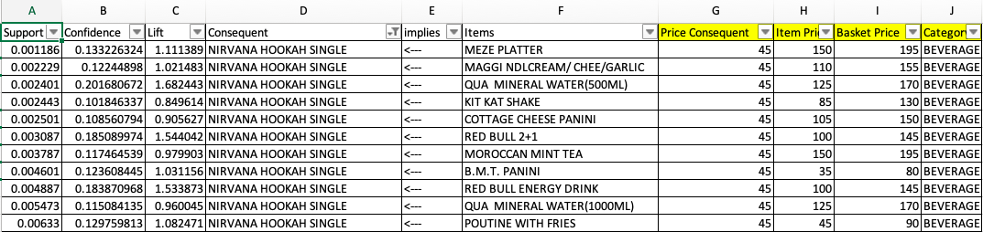
Marketing and Retail Analytics – Coffee Café
Basket 3
Cup 17
The Basket 3 is measured with the total basket price from ₹140 to ₹905 in the consequent items as Great Lakes Shake will be added to the items Veg Club Wrap, Vanilla Ice cream, Maggi NDL Arrabiata where the customer is offers the value of ₹140 as Great Lakes Shake and B.M.T Panini.
Basket 4
The Basket 4 is measured for the various items with Nirvana Hookah Single and the basket price is measured for ₹80 is offered for the combo Nirvana Hookah Single and B.M.T Panini.
Marketing and Retail Analytics – Coffee Café

Slide 19
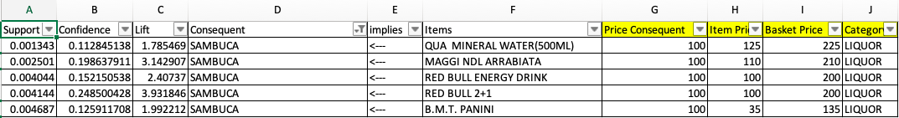
Marketing and Retail Analytics – Coffee Café
Basket 5
Cup 18
The Basket 5 is offered with the combo to customers with Sambuca and B.M.T which can be offered for the ₹135 to the customers and can be offered with Mineral water, Maggi, Red Bull Energy Drink.
Basket 6
The Basket 6 is offered with the combo to customers with B.M.T Panini for the items French fries, Maggi and Add fries for the customer and the best offering for the B.M.T Panini with French Fries for ₹140 in the basket to the customers.
Marketing and Retail Analytics – Coffee Café

Slide 20
Marketing and Retail Analytics – Coffee Café
The Market Basket Analysis is measured for the items with best combo meals as to include B.M.T Panini with the food items such as French Fries, Sambuca, Nirvana Hookah Single, Great Lakes Shake and Poutine with Fries which is very less in combo prices and makes the best combo meals to serve the customers.
The customers buying B.M.T Panini is also wish to offer the above mentioned items and the basket can be analyzed with the less to higher price values and offered as best combo meals to the customers.
The main dishes can be increased with the B.M.T Panini as most of the customer have liked the taste and which is very less in rate to be offered by the customers as add-in dish in each customers.
Cup 19
Conclusion
The Coffee Café Restaurant is to create new combo meals by adding B.M.T Panini in higher moving dishes as add-on dish and the customers will encourage having the items at their mean time. The analyze factor of the items are marked with basket analysis in which some dishes are not frequently brought and the dishes to be improvise in cost and making tasty to the customers.
Marketing and Retail Analytics – Coffee Café

Slide 21
References
EDA
Project 9 Coffee Cafe.twbx
https://public.tableau.com/profile/numer.p#!/vizhome/Book1_15995136612160/Story1
Market Basket Analysis
Project 9 Coffee Cafe 1.knwf
Basket Creation with Price
Project 9 Coffee Cafe.xlsx

